Slide 1
Riordan Manufacturing
SR-rm-013 Project
Bryce Abdo, Nathan Bachmeier, Patrick Kemp, Melissa Ramirez, Jeffrey Suarez
CMGT/441
June 16, 2014
Alexander Pons

Slide 2


Data security issues and concerns present at each Riordan plant
Tools
No network can ever be 100% protected against online threats.
However, there are several tools available to business organizations to help
and provide as secure a network as possible.
Anti-Virus programs with additional Malware protection.
Hardware Firewall Systems, to include intrusion detection
Cloud Data Storage Systems
Wi-Fi Encryption
E-mail protection
Card Processing Fraud Prevention
Secure Network Access
Most important tool of All – Compliance to the terms of Use policy
Notes:
http://www.businessbee.com/resources/technology/7-best-data-privacy-tools-for-your-business/

Slide 3
Physical and Network Security
Internal vs External Threats
External are targeted attacks outside the organization
Internal are attacks from employees of the company
Physical Network Security Issues and Concerns
Riordan spans 4 locations
Transmission over the WAN needs to be secured
Adoption of Antivirus
Safeguard of NAS and email servers

Slide 4
Data Security Concerns
Concerns with Tool Adoption
Requires proper training
Requires backup and recovery planning
Record Keeping
Ensuring compliance with data retention laws
Denial of Service
Attacks that overload a service to prevent legitimate traffic
Elevation of Privilege Bugs
Attacks that by pass security policy or protections

Slide 5
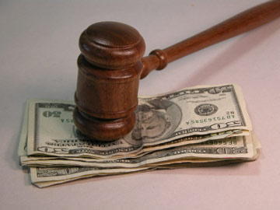
Data security issues and concerns present at each Riordan plant
Compliance with Data security Laws
With concerns about the several security mandates such as Sarbanes-Oxley (SOX) and others, Riordan must be diligent as it relates to their levels of compliance.
Failing to comply could expose Riordan to unwanted press and damage the image and brand or the company.
There are also financial loses that would accompany such exposure such as decreases in sales, decrease in market value as well the assessed fines for failing to comply with the federal and state regulations.

Slide 6
Web Security Concerns
Global
Need to provide Confidentiality, Integrity and Availability (C.I.A)
Proper use of Firewalls and Network Isolation
China Location Specifically
Protecting against Denial of Services
Ensuring proper insight into device behavior
Protection of the Satellite Communication Channels
Head Quarters
Risks from visitors and dumpster diving

Slide 7
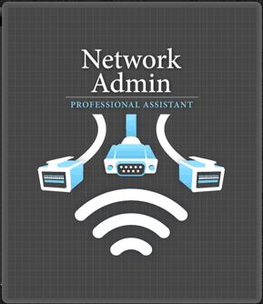
Data security issues and concerns present at each Riordan plant
Administrators & Training
The roles of system administrators and IT managers have seemed to merged with other roles due to the ever changes in the areas of state and federal compliance requirements. This include the continued federal regulations related to data protection and retention. It is essential that Riordan employee experienced staff as well as provide them up to date training in the areas of compliance.
Today however, more automated processes are available to manage the archiving and safe storage as well as protection of network data.

